Slide 1
XHTML, XML and XSLT

Slide 2
XHTML – EXtensible HyperText Markup Language
is HTML defined as an XML application
is a stricter and cleaner HTML
is compatible to HTML 4.01 and supported by all browsers
is a W3C recommendation

Slide 3
Why XHTML ?
the following, “bad” html document will work fine in most browser even if it does not follow HTML rules:
<html>
<head>
<body>
<p>a paragraph…<br>
<a href=“#”>test
</html>
but browsers running on hand-held devices (e.g. mobile phones) have small computing power and can not interpret “bad” markup language
HTML is designed to structure (and display) data and XML is designed to describe and structure data
XHTML specifies that everything must be marked up correctly

Slide 4
XHTML – base syntactic rules
XHTML elements must be properly nested
<b><i> Italic and bold text </b></i>
<b><i> Italic and bold text </i></b>
XHTML elements must always be closed
<p> A paragraph…
<br>
<img src=“foo.jpg”>
<p> A paragraph…</p>
<br />
<img src=“foo.jpg” />
XHTML elements must be in lowercase
XHTML elements must have one <html> root element (which contains a <head> and a <body>)

Slide 5
XHTML – other syntactic rules
attribute names must be in lower case
attribute values must be quoted
<table width=300px>
<table width=“300px”>
the “id” attribute replaces the “name” attribute
XHTML DTD defines mandatory elements
attribute minimization is forbidden
<input checked>
<input disabled>
<input checked=“checked” />
<input disabled=“disabled” />

Slide 6
General format of an XHTML document
<!DOCTYPE html PUBLIC "-//W3C//DTD XHTML 1.0 Transitional//EN"
"http://www.w3.org/TR/xhtml1/DTD/xhtml1-transitional.dtd">
<html>
<head>
<title>…</title>
</head>
<body>
…
</body>
</html>
<!Doctype>,<html>,<head>,<title>,<body> are mandatory

Slide 7
DTD – Document Type Definition
a DTD specifies the syntax of a document written in a SGML language (HTML, XHTML, XML)
it specifies:
  the hierarchical structure of the document,
  element names and types
  element content type
  and attributes names and values
XML 1.0 has 3 DTDs: Strict, Transitional and Frameset

Slide 8
DTD example (internal to XHTML file)
<!DOCTYPE course [
<!ELEMENT course (lecture+)>
<!ELEMENT lecture (title,bibliography,notes,examples)>
<!ELEMENT title (#PCDATA)>
<!ELEMENT bibliography (#PCDATA)>
<!ELEMENT notes (#PCDATA)>
<!ELEMENT examples (#PCDATA)>
<!ATTLIST course professor CDATA #REQUIRED>
<!ATTLIST course title CDATA #REQUIRED>
<!ATTLIST course yearofstudy CDATA #REQUIRED>
<!ATTLIST course date CDATA #IMPLIED>
]>

Slide 9
XHTML validation
a valid XHTML document is an XHTML document which obeys the rules of the DTD specified by the <!Doctype> tag.
the official W3C XHTML validator:
http://validator.w3.org/check/referer
XHTML DTD is split in 28 modules

Slide 10
XML – eXtensible Markup Language

Slide 11
XML – eXtensible Markup Language
is a markup language designed for storage and transport of data
describes syntax and semantics of data, while HTML/XHTML describes only syntax of data
is a markup language for structuring and self-describing data (not for formatting data); HTML/XHTML is for structuring and formatting/displaying data
is a meta-language, a language used to create other markup languages (XHTML, XSLT, RDF, SMIL etc.)
does not have predefined tags; these are defined by users
is easy readable by both humans and machines
is plain text, software and hardware independent
is a W3C recommendation

Slide 12
XML Document example
<?xml version=“1.0”?>
<collection>
<book category=“Networking”>
<title>High Performance TCP Networking</title>
<author>Raj Jain</author>
<isbn>567-78960</isbn>
<editor>Prentice Hall</editor>
</book>
<book category=“Databases”>
<title>Transactional Information Systems</title>
<author>Gottfried Vossen</author>
<author>Gerhard Weikum</author>
<isbn>680-71060</isbn>
<editor>Morkan Kaufman Publishing</editor>
</book>
<book category=“Mathematics”>
<title>Mathematical Encyclopedia</title>
<author>Eric Weistein</author>
<isbn>545-678450</isbn>
<editor>Addison Wesley</editor>
</book>
</collection>

Slide 13
XML usage on the web
XML’s popularity as a format for storing and interchanging data is high and increasing on the web
because is self-describing it is more easily understood by different incompatible systems which interchange data and also reduces complexity of parsing it by different machines (computers, hand-held devices, news readers etc.)
because it is plain text it copes very well with platform upgrades (e.g. hardware, operating system, application, framework)
is a competitor of relational databases for storing data on the web => semi-structured databases (more structured than plain text, but less structured than relational databases)

Slide 14
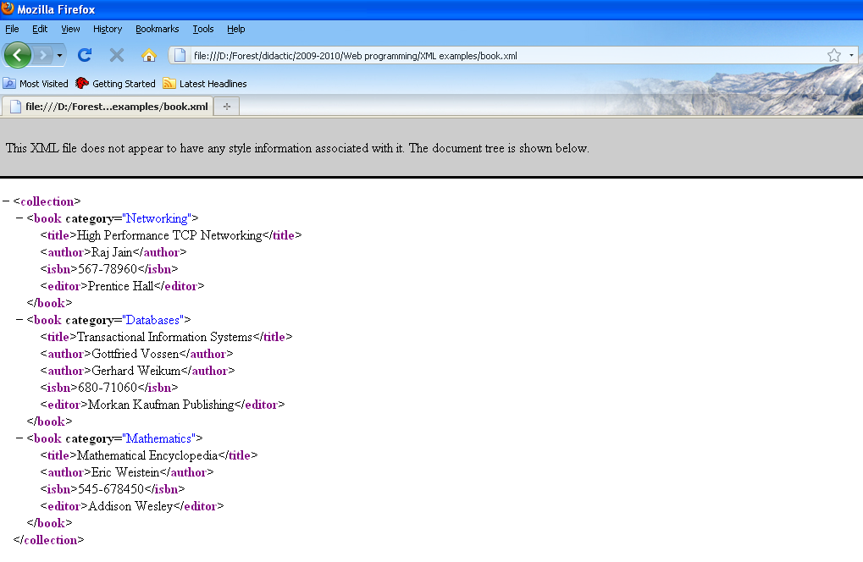
The tree structure of an XML document
an XML document has a tree structure which is implicitly displayed in the browser viewing the document:

Slide 15
XML – syntactic rules
all XML elements must have a closing tag
XML elements are case-sensitive
XML elements must be properly nested, not overlap
XML documents must have only one root element which is the parent of all elements; “<?xml?>” is not part of the document itself
values of XML attributes must be quoted
characters “<“ and “&” are illegal in XML; use predefined entity references (“&lt;” – “<“, “&gt;” – “>”, “&amp;” – &, “&apos;” – “ ‘ “, “&quot;” – “ “ “)
comments in XML: <!-- … -->
white-space is preserved in XML (not like HTML)
XML stores newline as LF (Line Feed)

Slide 16
XML elements
XML does not have predefined tags
an XML tag can have any name respecting the following rules:
  can contain letters, numbers and other characters
  can not start with a number or punctuation character
  can not start with the letters xml (or XML or Xml etc.)
  can not contain spaces
an XML tag can contain text and other nested tags
an XML tag can also have attributes

Slide 17
XML well-formedness and validation
well-formed XML – an XML document compliant to XML syntactic rules
valid XML – an XML document compliant to a DTD or XML Schema
a DTD can be specified inside the XML document after the “<?xml?>” tag or it can be specified in a separate file and referenced in the XML file by:
<!DOCTYPE collection SYSTEM “collection.dtd”>
an XML Schema is an alternative to a DTD and can be referenced in the XML file using attributes of the root tag:
<collection xmlns="http://www.cs.ubbcluj.ro"
xmlns:xsi="http://www.w3.org/2001/XMLSchema-instance"
xsi:schemaLocation="http://www.cs.ubbcluj.ro collection.xsd">

Slide 18
A DTD for the collection.xml document
<!ELEMENT collection (book+)>
<!ELEMENT book (title,author+,isbn,editor)>
<!ELEMENT title (#PCDATA)>
<!ELEMENT author (#PCDATA)>
<!ELEMENT isbn (#PCDATA)>
<!ELEMENT editor (#PCDATA)>
<!ATTLIST book category CDATA #REQUIRED>

Slide 19
A schema for the collection.xml document
<?xml version="1.0"?>
<xs:schema xmlns:xs="http://www.w3.org/2001/XMLSchema">
<xs:element name=“collection">
<xs:complexType>
<xs:sequence>
<xs:element name=“book">
<xs:complexType>
<xs:attribute name=“category” type=“xs:string” />
<xs:sequence>
<xs:element name=“title" type="xs:string"/>
<xs:element name=“author" type="xs:string“
minOccurs=“1” maxOccurs=“10” />
<xs:element name=“isbn" type="xs:string"/>
<xs:element name=“editor" type="xs:string"/>
</xs:sequence>
</xs:complexType>
</xs:element>
</xs:sequence>
</xs:complexType>
</xs:element>
</xs:schema>

Slide 20
XML Schema
XML Schema Definition (XSD) is the successor of DTDs
like a DTD, an XSD defines:
  the elements which appear in the XML doc and their attributes
  the order/hierarchical structure of these elements
  the number of child elements of a specific type
  whether the element is empty or it has content
  default and fixed values for elements and attributes
additional to DTDs, XSDs:
  support basic data types (e.g. numerical, date, string etc.)
  support namespaces (for solving collisions)
  use XML syntax

Slide 21
XML Namespaces
in XML users define tags; when integrating 2 different xml applications, tag conflicts can appear
XML Namespaces try to solve name conflicts
ex. of an XML doc with name conflicts:
<document>
<studies>
<year_of_study name=“1”>
<group>211</group>
<group>212</group>
</year_of_study>
<year_of_study name=“2”>
…
</year_o_study>
</studies>
<courses>
<group name=“Databases”>
<course>Relational Databases</course>
<course>Database Systems Fundamentals</course>
</group>
<group name=“Operating Systems”>
…
</group>
</courses>
</document>

Slide 22
XML Namespaces (2)
Xml doc with prefix namespaces:
<document>
<st:studies xmlns:st=“http://www.cs.ubbcluj.ro/studies”>
<st:year_of_study name=“1”>
<st:group>211</st:group>
<st:group>212</st:group>
</st:year_of_study>
<st:year_of_study name=“2”>
…
</st:year_o_study>
</st:studies>
<co:courses xmlns:co=“http://www.cs.ubbcluj.ro/courses”>
<co:group name=“Databases”>
<co:course>Relational Databases</co:course>
<co:course>Database Systems Fundamentals</co:course>
</co:group>
<co:group name=“Operating Systems”>
…
</co:group>
</co:courses>
</document>

Slide 23
XML Namespaces (3)
the namespace for a prefix must be defined using the xmlns attribute
xmlns attribute can be placed in any tag (and it will be valid for that tag and all its children) or in the root tag like this:
<document xmlns:st=“http://www.cs.ubbcluj.ro/studies”
xmlns:co=“http://www.cs.ubbcluj.ro/courses”>
each namespace URI should be unique and should not necessary point to a page containing namespace information
the default namespace for the document is introduced by the xmlns attribute:
<document xmlns=“http://www.cs.ubbcluj.ro”>

Slide 24
XML Viewing
if an XML document has errors (i.e. it is not well-formed), it will not be displayed in a browser as opposed to HTML which will be displayed if it has errors (the XML W3C standard specifies that an XML parser should stop when an error is found)
the default display of an XML browser is its tree structure, because XML does not contain display/formatting information
an XML can be displayed differently (formatted) using CSS or XSLT

Slide 25
Formatting XML with CSS
CSS files are referenced in an XML file using the tag:
<?xml-stylesheet type=“text/css” href=“book.css”?>
the book.css file:
book { title {
display: block; display: inline-block;
border-bottom-style: solid; width: 30%;
border-bottom-width: 1px; background-color: #ccefef;
width: 80%; padding-right: 5px;
margin-left: auto; }
margin-right: auto;
} isbn { display: inline-block;
author { width: 15%;
display: inline-block; border-left-style: solid;
width: 15%; border-left-width: 1px;
border-left-style: solid; padding-left: 5px;
border-left-width: 1px; }
padding-left: 5px;
}
editor {
display: inline-block;
width: 20%;
border-left-style: solid;
border-left-width: 1px;
padding-left: 5px;
}

Slide 26
XPointer and XLink
XPointer defines a standard way of referencing various objects inside an xml document
href="http://www.example.com/cdlist.xml#id('rock').child(5,item)"
XLink defines a standard way of creating hyperlinks in XML documents
<homepage xlink:type="simple"
xlink:href="http://www.w3schools.com">Visit W3Schools</homepage>

Slide 27
XSLT – eXtensible Stylesheet Language Transformations

Slide 28
What is XSL?
XSL (eXtensible Stylesheet Language) was developed by the W3C because of a need for an XML-based stylesheet language
in HTML each tag is predefined and it already contains some default display information in its name, so it is easy to format it using CSS; in XML each tag can mean anything, so it is harder for XSL to format a tag
XSL consists of:
  XSLT – language for transforming XML documents
  XPath – language for navigating inside XML documents
  XSL-FO – language for formatting XML documents

Slide 29
What is XSLT?
XSLT if used for transforming an XML document in another XML document
XSLT is the most important part of XSL
XSLT can add/remove elements and attributes to an XML document, can rearrange and sort them, can hide or display elements
XSLT uses XPath for parsing the XML document

Slide 30
XSLT example
<?xml version=“1.0”?>
<xsl:stylesheet version=“1.0“ xmlns:xsl="http://www.w3.org/1999/XSL/Transform">
<xsl:template match="/">
<html>
<body>
<h2>A Book Collection</h2>
<table border=“1”>
<xsl:for-each select=“collection/book”>
<tr>
<td><xsl:value-of select=“title”/></td>
<td><xsl:value-of select=“author”/></td>
<td><xsl:value-of select=“isbn”/></td>
<td><xsl:value-of select=“editor”/></td>
</tr>
</xsl:for-each>
</table>
</body>
</html>
</xsl:template>
</xsl:stylesheet>
an XML file can be linked to an XSLT by specifying:
<?xml-stylesheet type=“text/xsl” href=“book.xsl”?>

Slide 31
<xsl:template>
syntax:
<xsl:template match=“XPath expression”>…</xsl:template>
meaning: it builds a template and associates this template with an XML element/tag
the match attribute associates the template with a specific XML element
<xsl:template match=“/”> matches the root element of the XML document

Slide 32
<xsl:value-of>
syntax:
<xsl:value-of select=“XPath expression” />
meaning: it extracts the value (content) of the selected node (specified by the select attribute)
example:
<xsl:value-of select=“collection/book/title” />
it selects the value of the current “title” element, which is a child of “book”, which is a child of “collection”

Slide 33
<xsl:for-each>
syntax:
<xsl:for-each select=“XPath expression”>…</xsl:for-each>
meaning: it selects each XML child node of the node specified by the select attribute
examples:
1) <xsl:for-each select=“collection/book”>
<xsl:value-of select=“title” />
<xsl:value-of select=“author” />
</xsl:for-each>
it selects the “title” and “author” nodes which are children of all “book” nodes from a “collection” node
2) <xsl:for-each select=“collection/book[title=“Operating Systems”]>
it filters the selection using a value for the content of a book node

Slide 34
<xsl:sort>
syntax:
<xsl:sort select=“XPath expression” />
meaning: it sorts the output inside a <xsl:for-each> element on the value specified by the select attribute
example:
<xsl:sort select=“title” />

Slide 35
<xsl:if>
syntax:
<xsl:if test=“expression”>
… output in case the expression is true …
</xsl:if>
meaning: it adds a conditional test in the processing flow; the expression can contain the operators:
  = (equal)
  != (not equal)
  &lt; (little than)
  &gt; (greater than)
example:
<xsl:if test=“title=‘Operating Systems’”>…</xsl;if>

Slide 36
<xsl:choose>
syntax:
<xsl:choose>
<xsl:when test="expression">
... some output ...
</xsl:when>
<xsl:otherwise>
... some output ....
</xsl:otherwise>
</xsl:choose>
meaning: is used for multiple conditional testing

